Slide 1

AS and A-level Maths route map
Scheme of work for two teachers
Version 1.0, September 2017

Slide 2
A-level Maths route map
Scheme of work for two teachers
Year 1: AS Mathematics
Year 2: A-level Mathematics
This route map has been created to provide a suggested teaching route for two teachers delivering the AS and A-level Mathematics specification over two years.
It is designed to enable students to sit AS Maths at the end of Year 1, and A-level Maths at the end of Year 2.
In each week, one teacher should deliver the content in the top row of tiles and a second teacher should deliver the content in the bottom row of tiles.
Please note this route map provides a suggested route to teaching the qualification. The topics can be taught in any order over any length of time to suit your own students.

Slide 3
How to use the route map
To activate the route map, open it in PowerPoint, click on the Slide Show tab followed by the From Beginning button in the navigation bar.
To customise the route map, drag and drop the coloured tiles to move topics around, and extend or reduce the size of the tiles to adjust the teaching time. You can then save your customised version of the route map.
Clicking on a topic tile will give further information about the specification references and specification notes. Supporting resources for this teaching route are available on All About Maths.

Slide 4
AS and A-level Mathematics Mathematics two-year route map
Algebra and proof
Geometry
Calculus
Trigonometry
Exponentials and logarithms
Sequences and series
Numerical
methods
Statistics
Mechanics

Slide 5
Use of data in statistics
The Department for Education (DfE) have set out the following requirements regarding the use of data in statistics as follows:
9. AS and A level mathematics specifications must require students to:
become familiar with one or more specific large data set(s) in advance of the final assessment (these data must be real and sufficiently rich to enable the concepts and skills of data presentation and interpretation in the specification to be explored)
use technology such as spreadsheets or specialist statistical packages to explore the data set(s)
interpret real data presented in summary or graphical form
use data to investigate questions arising in real contexts.
10. Specifications should require students to explore the data set(s), and associated contexts, during their course of study to enable them to perform tasks that assume familiarity with the contexts, the main features of the data and the ways in which technology can help explore the data. Specifications should also require students to demonstrate the ability to analyse a subset or features of the data using a calculator with standard statistical functions, as detailed in paragraph 8 (please see DfE content for further information).
We encourage the use of statistical data sets and statistical packages throughout the course of study of statistics. In this route map, we have set aside two weeks in year 12, weeks 35, 41 and 42, to encourage independent interrogation of data. In week 41, we suggest students study an A-level statistics topic and in week 35 and 42, we suggest students complete an activity using statistical packages. Note: It is up teachers to decide which statistics topics to use with statistical data sets and packages. The weeks suggested and the content suggested (N2 and N3) is an example.

Slide 6
A-level Year 2(new spec) – September 2018 (Mon 3&4, Tue 6&7, Thurs 1&2)
Starters to revisit AS topics
3-7 Sept | 10-14 Sept | 17-21 Sept | 24-28 Sept | 1-5 Oct | 8-12 Oct | 15-19 Oct | 22 – 26 Oct Holiday
29 – 2 Nov | 5 – 9 Nov | 12-16 Nov | 19-23 Nov | 26-30 Nov | 3-7 Dec | 10-14 Dec | 17-21 Dec
24-4 Jan Holiday | 7-11 Jan | 14-18 Jan | 21-25 Jan | 28-1 Feb | 4-8 Feb | 11-15 Feb | 18-22 Feb Holiday
25-1 Mar | 4-8 Mar | 11-15 Mar | 18-22 Mar | 25-29 Mar | 1-5 Apr | 8-12 Apr Holiday | 15-19 Apr Holiday
22-26 Apr | 29-3 May | 6-10 May | 13-17 May | 20-24 May | 27-31 May Holiday | 3-7 June | 10-14 June
17-21 June | 24-28 June | 1-5 July | 8-12 July | 15-19 July | 22-26 July Holiday | 29-2 Aug July Holiday | 5-9 August Holiday
Review summer task
E1-E5 Trigonometry and circular measure (14.1-14.2)
B6-B9 Functions and transformations (12.2, 12.4)
J1, J5, Q3-Q5 Kinematics in two dimensions
(18.1,18.3-18.4)
G1-G4 Further differentiation (15.1-15.6)
M2-M3 Further probability
(20.1-20.2)
E6, E8 Trigonometry (14.3-14.4)
N2, N3 Statistical distributions 20.3,20.4
H2 – H5 Further integration (16.1 -16.3)
Vectors in 3D (19.1)
B10, H6 Partial fractions and integration (12.5, 16.4)
PPE
Week
D1 – D6 Binomial theorem, sequences and series (13.1-13.4)
Partial fractions and integration
C3-C4, G4-G5 Parametric equations (12.3, 15.7, 15.8)
Statics and dynamics
O1, O3 Statistical hypothesis testing (21.1, 21.2)
I1 – I4 Numerical methods 17.1 – 17.4
R5, R6 Statics and dynamics (19.2,19.3)
B11, G6, H7, H8 Differential equations (16.5)
Numerical methods
Paper 1
Core
(5)
Paper 2
Core/Mec
(12)
Paper 3
Core/Stat
(14 pm)
Moments (19.4)

Slide 7
A-level Mathematics - 2 year Co-teaching Route Map, - AS Maths year 1, A-level Maths year 2
(2017 specification)
Year 1: AS Mathematics
Suggested scheme of work for two teachers
Year 12
Algebraic manipulation, quadratic equations and simultaneous equations
Graphs, linear and quadratic inequalities
Differentiation
Holiday
Differentiation
Trigonometry
Binomial expansions
Straight lines and circles
Integration
Differentiation
Mock examinations
and revision
Mock examinations
and revision
Holiday
Holiday
Statistical sampling
Data presentation and interpretation
Integration
Vectors
Data presentation and interpretation
Probability and statistical distributions
Holiday
Exponentials and logarithms
Holiday
Vectors
Proof
Kinematics in one dimension
Revision
Holiday
Probability and statistical distributions
Statistical hypothesis testing
Analysis of data using statistical packages
Summer
examinations
and revision
Summer
examination
and revision
Holiday
Summer
examinations
and revision
Summer
examinations
and revision
Forces and Newton’s laws
Statistical distributions
Analysis of data using statistical packages
Year 13

Slide 8
A-level Mathematics - 2 year Co-teaching Route Map, - AS Maths year 1, A-level Maths year 2
(2017 specification)
Year 2: A-level Mathematics
Suggested scheme of work for two teachers
Year 13
Binomial theorem, sequences and series
Further differentiation
Holiday
Further differentiation
Parametric equations
Trigonometry and circular measure
Functions and transformations
Further integration
Further integration
Parametric equations
Numerical methods
Mock examinations
and revision
Mock examinations
and revision
Holiday
Holiday
Trigonometry
Further integration
Numerical methods
Partial fractions and integration
Differential equations
Holiday
Differential equations
Further probability
Holiday
Holiday
Kinematics in two dimensions
Kinematics in two dimensions
Equilibrium and resolving
Statics and dynamics
Statistical distributions
Statistical hypothesis testing
Revision
Summer
examinations
and revision
Summer
examinations
and revision
Holiday
Summer
examinations
and revision
Summer
examinations
and revision
Statics and dynamics
Moments
Statistical hypothesis testing
Summer
examinations
and revision
Summer
examinations
and revision
Year 12

Slide 9
Year 1
AS Mathematics

Slide 10
Algebraic manipulation, quadratic equations
and simultaneous equations (slide 1 of 2)
 | Specification content: | Specification notes:
B1 | Understand and use the laws of indices for all rational exponents
B2 | Use and manipulate surds, including rationalising the denominator
B3 | Work with quadratic functions and their graphs; the discriminant of a quadratic function, including the conditions for real and repeated roots; completing the square; solution of quadratic equations including solving quadratic equations in a function of the unknown
Continued on next page

Slide 11
Algebraic manipulation, quadratic equations
and simultaneous equations (slide 2 of 2)
 | Specification content: | Specification notes:
B4 | Solve simultaneous equations in two variables by elimination and by substitution, including one linear and one quadratic equation
B6 | Manipulate polynomials algebraically, including expanding brackets and collecting like terms, factorisation and simple algebraic division; use of the factor theorem | Assumed knowledge: simplifying and manipulating algebraic expressions Simplifying rational expressions will be covered in year 13, Functions and transformations

Slide 12
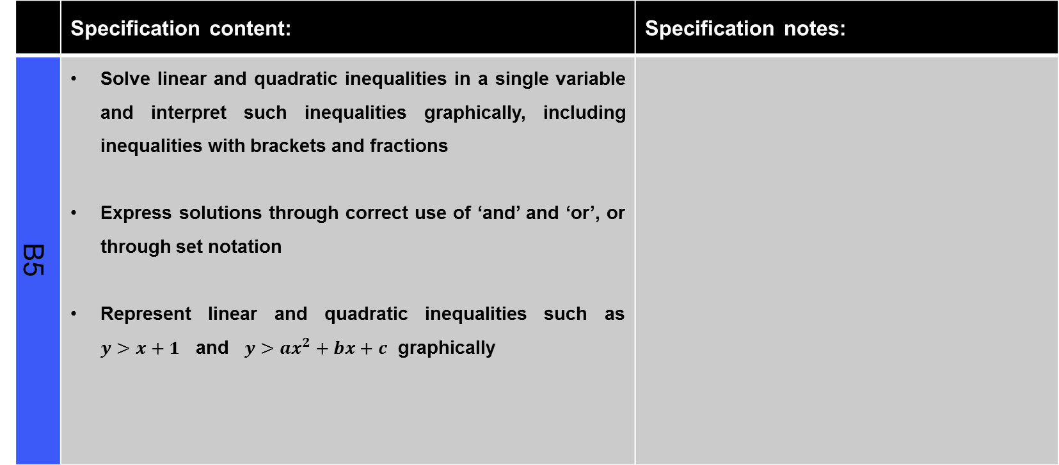
Graphs, linear and quadratic inequalities (slide 1 of 3)
 | Specification content: | Specification notes:
B5 | Solve linear and quadratic inequalities in a single variable and interpret such inequalities graphically, including inequalities with brackets and fractions Express solutions through correct use of ‘and’ and ‘or’, or through set notation Represent linear and quadratic inequalities such as $y>x+1$ and $y>ax^{2}+bx+c$ graphically
Continued on next page

Slide 13
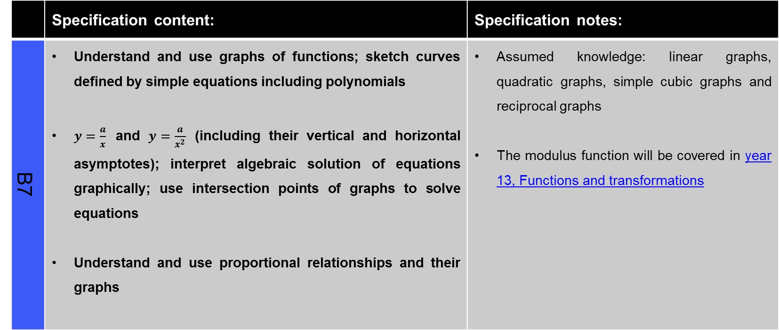
Graphs, linear and quadratic inequalities (slide 2 of 3)
 | Specification content: | Specification notes:
B7 | Understand and use graphs of functions; sketch curves defined by simple equations including polynomials $y=\frac{a}{x}$ and $y=\frac{a}{x^{2}}$ (including their vertical and horizontal asymptotes); interpret algebraic solution of equations graphically; use intersection points of graphs to solve equations Understand and use proportional relationships and their graphs | Assumed knowledge: linear graphs, quadratic graphs, simple cubic graphs and reciprocal graphs The modulus function will be covered in year 13, Functions and transformations
Continued on next page

Slide 14
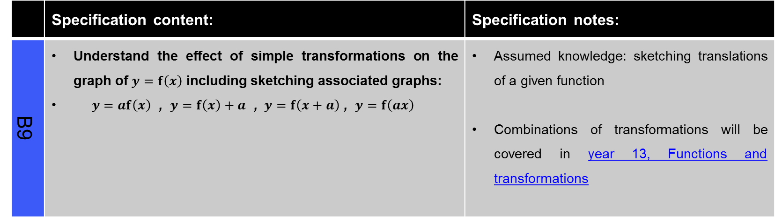
Graphs, linear and quadratic inequalities (slide 3 of 3)
 | Specification content: | Specification notes:
B9 | Understand the effect of simple transformations on the graph of $y=f\left(x\right)$ including sketching associated graphs: $y=af\left(x\right)$ , $y=f\left(x\right)+a$ , $y=f\left(x+a\right)$ , $y=f\left(ax\right)$ | Assumed knowledge: sketching translations of a given function Combinations of transformations will be covered in year 13, Functions and transformations

Slide 15
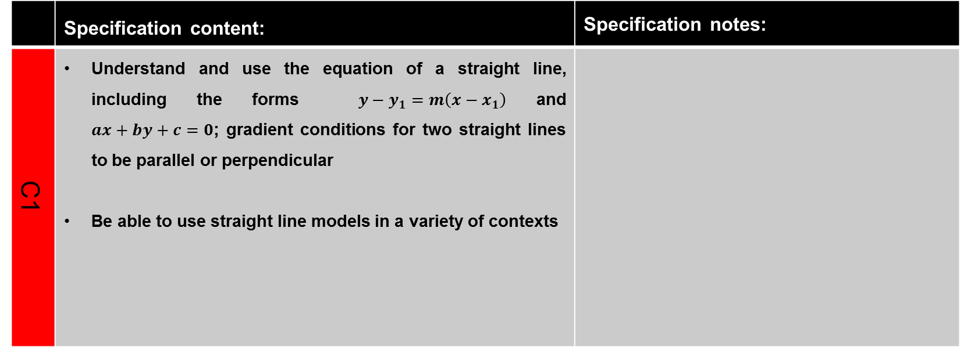
Straight lines and circles (slide 1 of 2)
 | Specification content: | Specification notes:
C1 | Understand and use the equation of a straight line, including the forms $y−y_{1}=m\left(x−x_{1}\right)$and $ax+by+c=0$; gradient conditions for two straight lines to be parallel or perpendicular Be able to use straight line models in a variety of contexts
Continued on next page

Slide 16
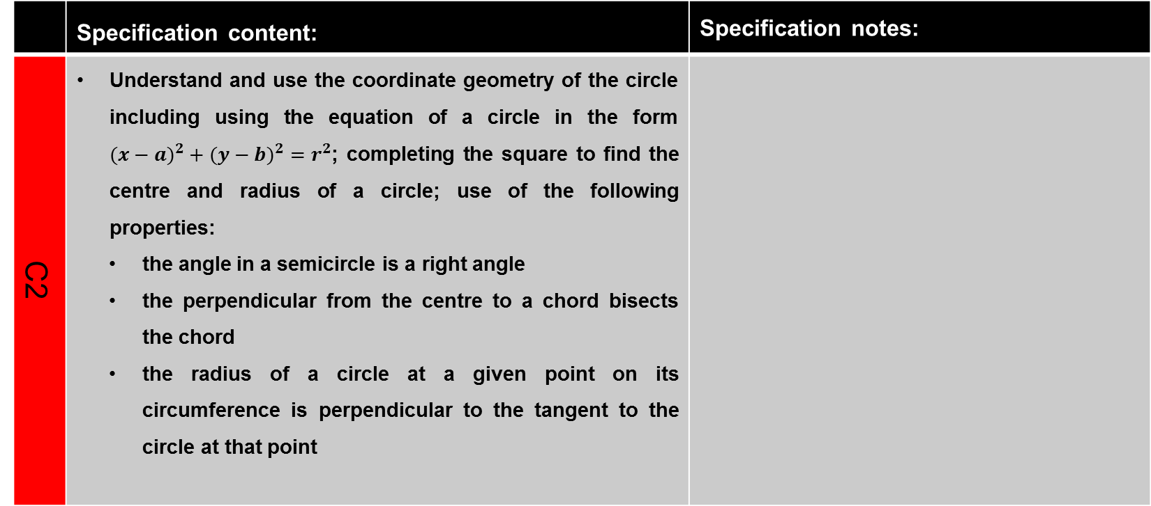
Straight lines and circles (slide 2 of 2)
 | Specification content: | Specification notes:
C2 | Understand and use the coordinate geometry of the circle including using the equation of a circle in the form $(x−{a)}^{2}+(y−{b)}^{2}=r^{2}$; completing the square to find the centre and radius of a circle; use of the following properties: the angle in a semicircle is a right angle the perpendicular from the centre to a chord bisects the chord the radius of a circle at a given point on its circumference is perpendicular to the tangent to the circle at that point

Slide 17
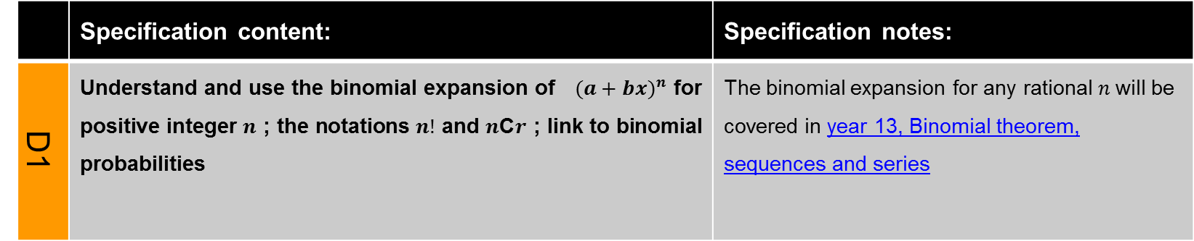
Binomial expansions
 | Specification content: | Specification notes:
D1 | Understand and use the binomial expansion of $(a+b{x)}^{n}$ for positive integer $n$ ; the notations $n!$ and $n$C$r$ ; link to binomial probabilities | The binomial expansion for any rational $n$will be covered in year 13, Binomial theorem, sequences and series

Slide 18
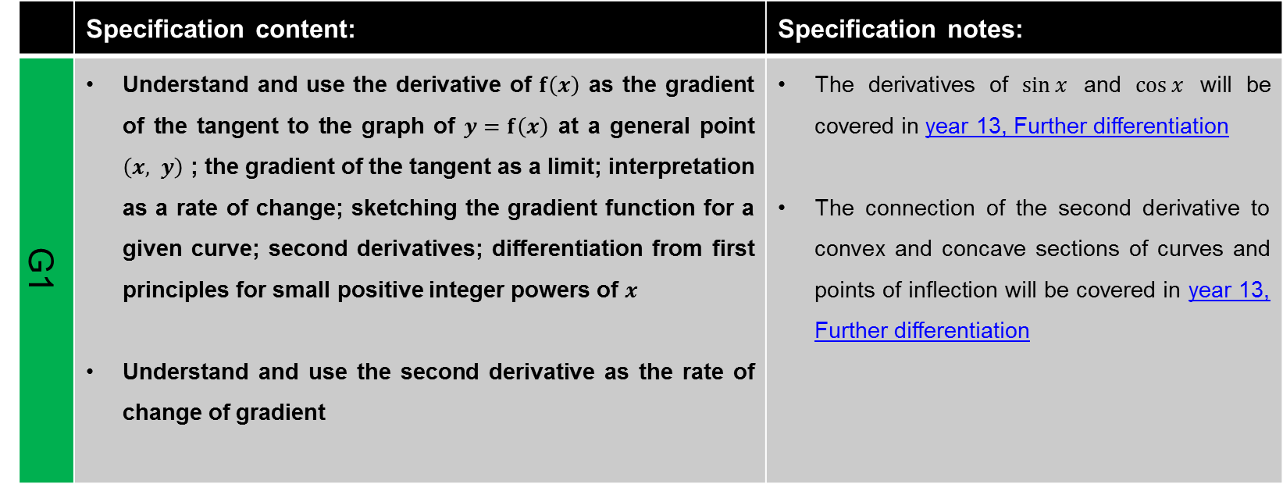
Differentiation (slide 1 of 2)
 | Specification content: | Specification notes:
G1 | Understand and use the derivative of $f\left(x\right)$ as the gradient of the tangent to the graph of $y=f\left(x\right)$ at a general point $\left(x, y\right)$ ; the gradient of the tangent as a limit; interpretation as a rate of change; sketching the gradient function for a given curve; second derivatives; differentiation from first principles for small positive integer powers of $x$ Understand and use the second derivative as the rate of change of gradient | The derivatives of $\sin{x}$ and $\cos{x}$ will be covered in year 13, Further differentiation The connection of the second derivative to convex and concave sections of curves and points of inflection will be covered in year 13, Further differentiation
Continued on next page

Slide 19
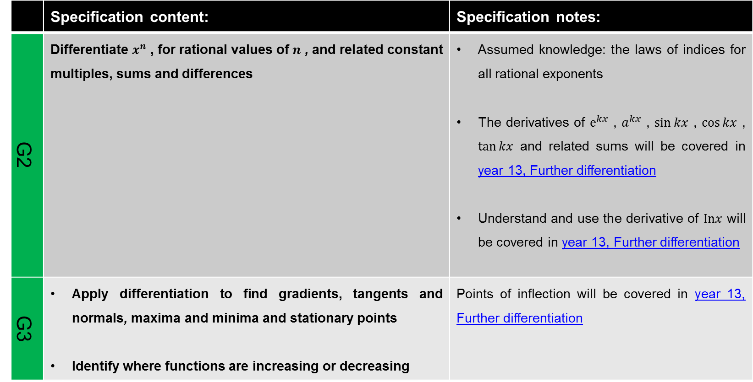
Differentiation (slide 2 of 2)
 | Specification content: | Specification notes:
G2 | Differentiate $x^{n}$ , for rational values of $n$ , and related constant multiples, sums and differences | Assumed knowledge: the laws of indices for all rational exponents The derivatives of $e^{kx}$ , $a^{kx}$ , $\sin{kx}$ , $\cos{kx}$ , $\tan{kx}$ and related sums will be covered in year 13, Further differentiation Understand and use the derivative of $Inx$ will be covered in year 13, Further differentiation
G3 | Apply differentiation to find gradients, tangents and normals, maxima and minima and stationary points Identify where functions are increasing or decreasing | Points of inflection will be covered in year 13, Further differentiation

Slide 20
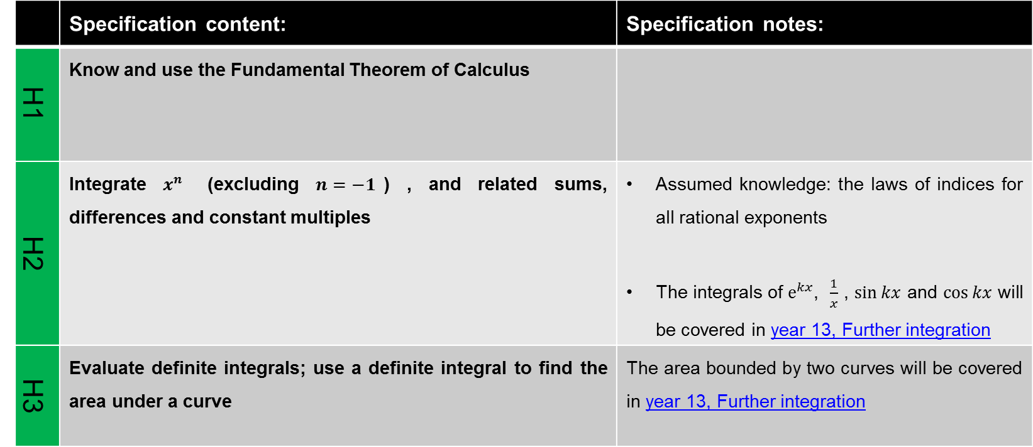
Integration
 | Specification content: | Specification notes:
H1 | Know and use the Fundamental Theorem of Calculus
H2 | Integrate $x^{n}$ (excluding $n=−1$) , and related sums, differences and constant multiples | Assumed knowledge: the laws of indices for all rational exponents The integrals of $e^{kx}$, $\frac{1}{x}$ , $\sin{kx}$ and $\cos{kx}$ will be covered in year 13, Further integration
H3 | Evaluate definite integrals; use a definite integral to find the area under a curve | The area bounded by two curves will be covered in year 13, Further integration

Slide 21
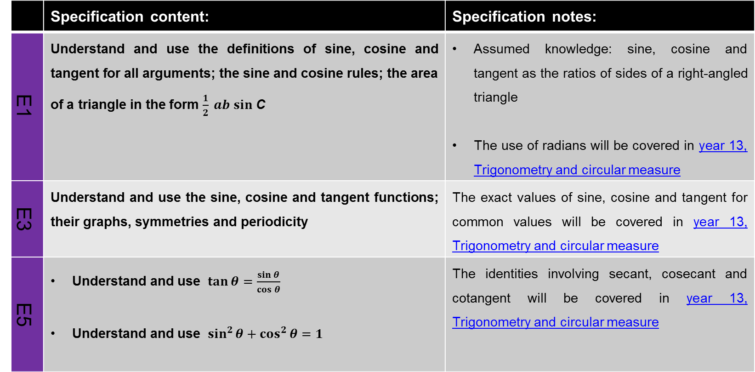
Continued on next page
Trigonometry (slide 1 of 2)
 | Specification content: | Specification notes:
E1 | Understand and use the definitions of sine, cosine and tangent for all arguments; the sine and cosine rules; the area of a triangle in the form $\frac{1}{2} ab sin$ C | Assumed knowledge: sine, cosine and tangent as the ratios of sides of a right-angled triangle The use of radians will be covered in year 13, Trigonometry and circular measure
E3 | Understand and use the sine, cosine and tangent functions; their graphs, symmetries and periodicity | The exact values of sine, cosine and tangent for common values will be covered in year 13, Trigonometry and circular measure
E5 | Understand and use $\tan{θ}=\frac{\sin{θ}}{\cos{θ}}$ Understand and use $\sin^{2}{θ+\cos^{2}{θ=1}}$ | The identities involving secant, cosecant and cotangent will be covered in year 13, Trigonometry and circular measure
Continued on next page

Slide 22
Continued on next page
Trigonometry (slide 2 of 2)
 | Specification content: | Specification notes:
E7 | Solve simple trigonometric equations in a given interval, including quadratic equations in sin, cos and tan and equations involving multiples of the unknown angle

Slide 23
Vectors (slide 1 of 2)
 | Specification content: | Specification notes:
J1 | Use vectors in two dimensions | Vectors in three dimensions will be covered in year 13, Kinematics in two dimensions
J2 | Calculate the magnitude and direction of a vector and convert between component form and magnitude/direction form
J3 | Add vectors diagrammatically and perform the algebraic operations of vector addition and multiplication by scalars, and understand their geometrical interpretations
J4 | Understand and use position vectors; calculate the distance between two points represented by position vectors
Continued on next page

Slide 24
Vectors (slide 2 of 2)
 | Specification content: | Specification notes:
J5 | Use vectors to solve problems in pure mathematics and in context, including forces | The use of vectors in kinematics problems will be covered in year 13, Kinematics in two dimensions

Slide 25
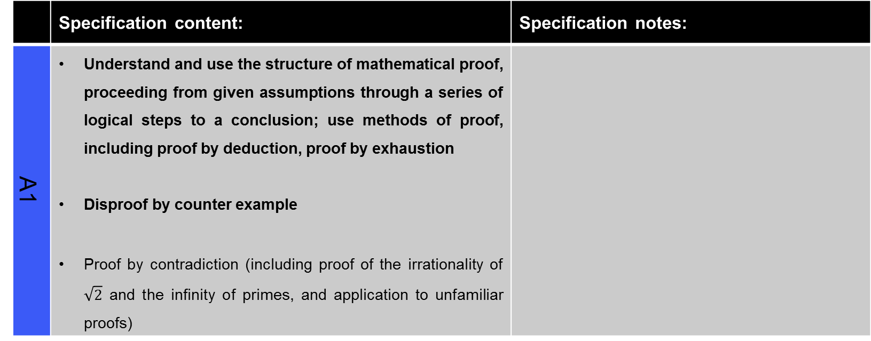
Proof
 | Specification content: | Specification notes:
A1 | Understand and use the structure of mathematical proof, proceeding from given assumptions through a series of logical steps to a conclusion; use methods of proof, including proof by deduction, proof by exhaustion Disproof by counter example Proof by contradiction (including proof of the irrationality of $\sqrt{2}$ and the infinity of primes, and application to unfamiliar proofs)

Slide 26
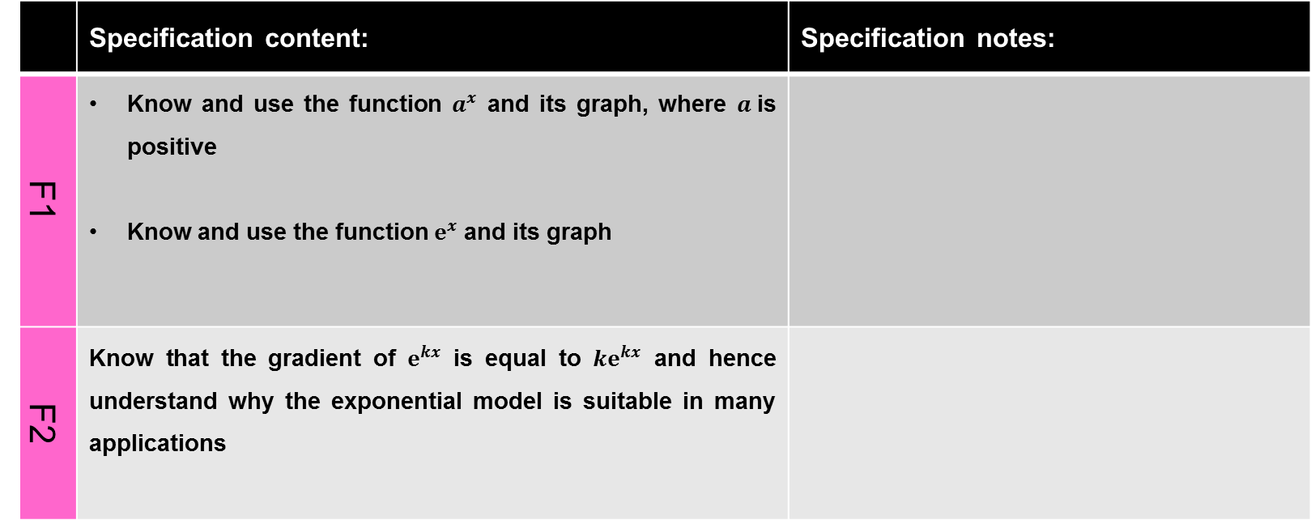
Exponentials and logarithms (slide 1 of 3)
 | Specification content: | Specification notes:
F1 | Know and use the function $a^{x}$ and its graph, where $a$is positive Know and use the function $e^{x}$ and its graph
F2 | Know that the gradient of $e^{kx}$ is equal to ${ke}^{kx}$ and hence understand why the exponential model is suitable in many applications
Continued on next page

Slide 27
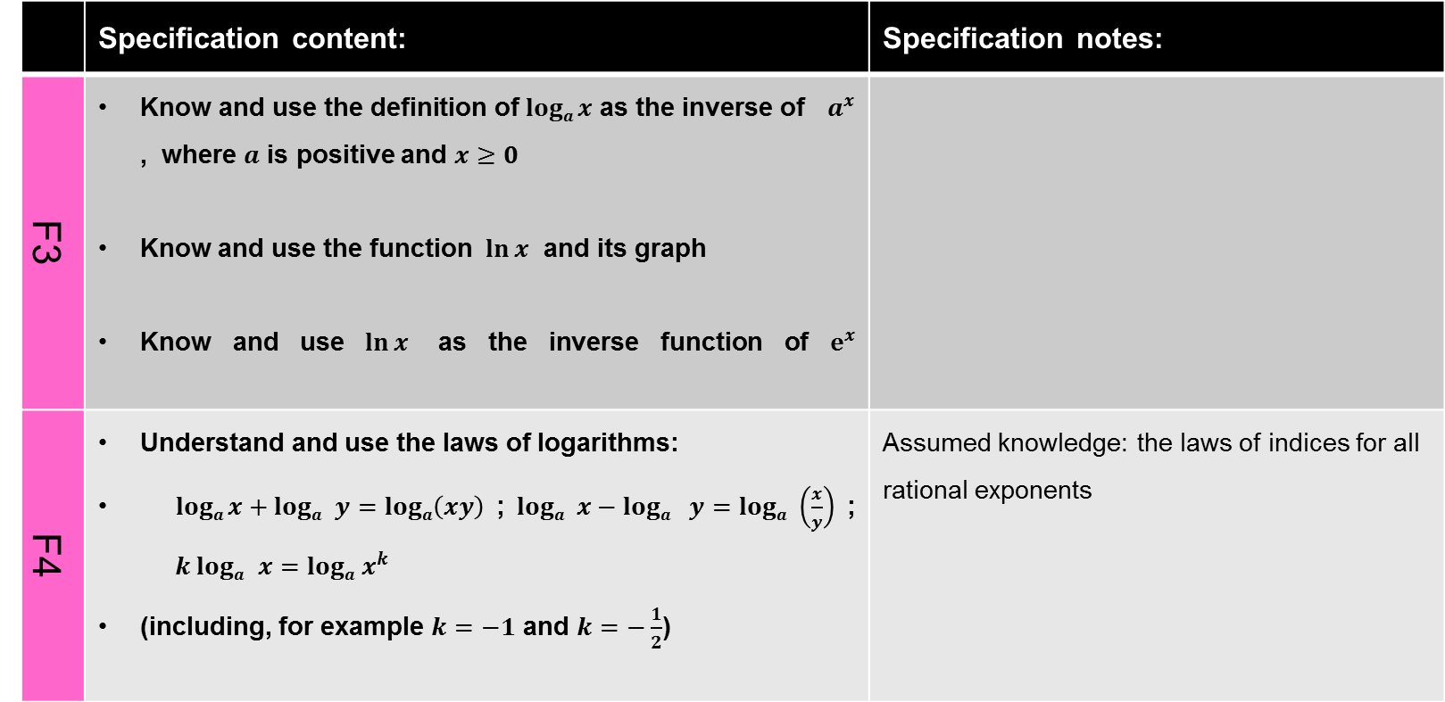
Exponentials and logarithms (slide 2 of 3)
 | Specification content: | Specification notes:
F3 | Know and use the definition of $loga x$ as the inverse of $a^{x}$ , where $a$ is positive and $x≥0$ Know and use the function $\ln{x}$ and its graph Know and use $\ln{x}$ as the inverse function of $e^{x}$
F4 | Understand and use the laws of logarithms: $loga x+loga$ $y=loga\left(xy\right)$ ; $loga$ $x−loga$ $y=loga$ $\left(\frac{x}{y}\right)$ ; $k loga$ $x=loga$ $x^{k}$ (including, for example $k=−1$ and $k=−\frac{1}{2}$) | Assumed knowledge: the laws of indices for all rational exponents
Continued on next page

Slide 28
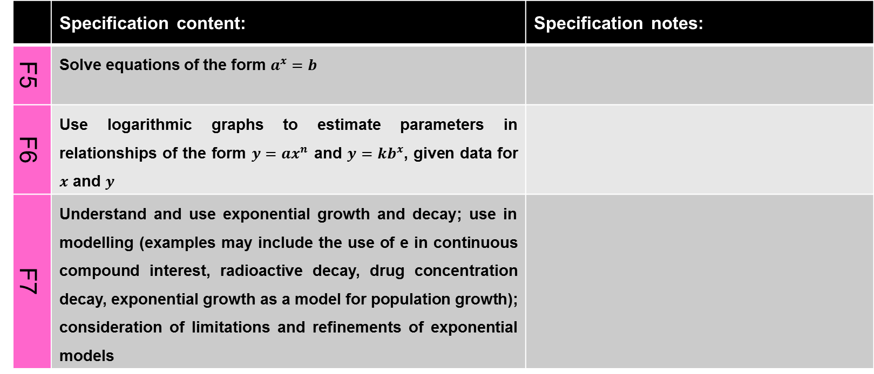
Exponentials and logarithms (slide 3 of 3)
 | Specification content: | Specification notes:
F5 | Solve equations of the form $a^{x}=b$
F6 | Use logarithmic graphs to estimate parameters in relationships of the form $y=ax^{n}$ and $y=kb^{x}$, given data for $x$ and $y$
F7 | Understand and use exponential growth and decay; use in modelling (examples may include the use of e in continuous compound interest, radioactive decay, drug concentration decay, exponential growth as a model for population growth); consideration of limitations and refinements of exponential models

Slide 29
Continued on next page
Statistical sampling
 | Specification content: | Specification notes:
K1 | Understand and use the terms ‘population’ and ‘sample’ Use samples to make informal inferences about the population Understand and use sampling techniques, including simple random sampling and opportunity sampling Select or critique sampling techniques in the context of solving a statistical problem, including understanding that different samples can lead to different conclusions about the population | See slide 5 Assumed knowledge: application of basic statistics to describe a population

Slide 30
Data presentation and interpretation (slide 1 of 3)
 | Specification content: | Specification notes:
L1 | Interpret diagrams for single-variable data, including understanding that area in a histogram represents frequency Connect to probability distributions | See slide 5
Continued on next page

Slide 31
Data presentation and interpretation (slide 2 of 3)
 | Specification content: | Specification notes:
L2 | Interpret scatter diagrams and regression lines for bivariate data, including recognition of scatter diagrams which include distinct sections of the population (calculations involving regression lines are excluded) Understand informal interpretation of correlation Understand that correlation does not imply causation | See slide 5 Assumed knowledge: recognise correlation and know that it does not indicate causation
Continued on next page

Slide 32
Continued on next page
Data presentation and interpretation (slide 3 of 3)
 | Specification content: | Specification notes:
L3 | Interpret measures of central tendency and variation, extending to standard deviation Be able to calculate standard deviation, including from summary statistics | See slide 5 Assumed knowledge: quartiles and inter-quartile range
L4 | Recognise and interpret possible outliers in data sets and statistical diagrams Select or critique data presentation techniques in the context of a statistical problem Be able to clean data, including dealing with missing data, errors and outliers | See slide 5

Slide 33
Continued on next page
Probability and statistical distributions
 | Specification content: | Specification notes:
M1 | Understand and use mutually exclusive and independent events when calculating probabilities Link to discrete and continuous distributions | See slide 5 Assumed knowledge: the 0 to 1 probability scale
N1 | Understand and use simple, discrete probability distributions (calculation of mean and variance of discrete random variables is excluded), including the binomial distribution, as a model; calculate probabilities using the binomial distribution | See slide 5

Slide 34
Continued on next page
Statistical hypothesis testing
 | Specification content: | Specification notes:
O1 | Understand and apply the language of statistical hypothesis testing, developed through a binomial model: null hypothesis, alternative hypothesis, significance level, test statistic, 1-tail test, 2-tail test, critical value, critical region, acceptance region, p-value | See slide 5 The use of correlation coefficients in hypothesis testing will be covered in year 13, Statistical hypothesis testing
O2 | Conduct a statistical hypothesis test for the proportion in the binomial distribution and interpret the results in context Understand that a sample is being used to make an inference about the population and appreciate that the significance level is the probability of incorrectly rejecting the null hypothesis | See slide 5

Slide 35
Continued on next page
Analysis of data using statistical packages
 | Specification content: | Specification notes
 | See slide 5

Slide 36
Kinematics in one dimension (slide 1 of 2)
 | Specification content: | Specification notes:
P1 | Understand and use fundamental quantities and units in the S.I. system: length, time, mass Understand and use derived quantities and units: velocity, acceleration, force, weight | Moments be covered in year 13, Moments
Q1 | Understand and use the language of kinematics: position; displacement; distance travelled; velocity; speed; acceleration
Continued on next page

Slide 37
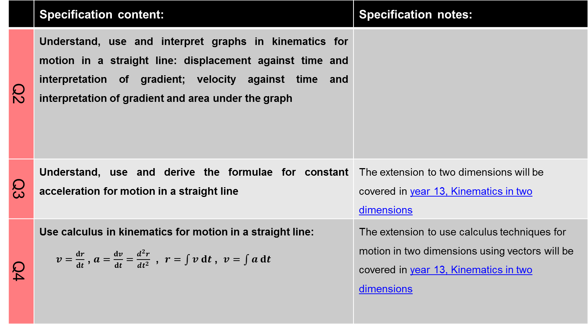
Kinematics in one dimension (slide 2 of 2)
 | Specification content: | Specification notes:
Q2 | Understand, use and interpret graphs in kinematics for motion in a straight line: displacement against time and interpretation of gradient; velocity against time and interpretation of gradient and area under the graph
Q3 | Understand, use and derive the formulae for constant acceleration for motion in a straight line | The extension to two dimensions will be covered in year 13, Kinematics in two dimensions
Q4 | Use calculus in kinematics for motion in a straight line: $v=\frac{dr}{dt}$ , $a=\frac{dv}{dt}=\frac{d^{2}r}{dt^{2}}$ , $r=\int{v dt}$ , $v=\int{a dt}$ | The extension to use calculus techniques for motion in two dimensions using vectors will be covered in year 13, Kinematics in two dimensions

Slide 38
Forces and Newton’s laws (slide 1 of 3)
 | Specification content: | Specification notes:
R1 | Understand the concept of a force; understand and use Newton’s first law
R2 | Understand and use Newton’s second law for motion in a straight line (restricted to forces in two perpendicular directions or simple cases of forces given as 2-D vectors) | The extension to situations where forces need to be resolved in two dimensions will be covered in year 13, Equilibrium and resolving
Continued on next page

Slide 39
Forces and Newton’s laws (slide 2 of 3)
 | Specification content: | Specification notes:
R3 | Understand and use weight and motion in a straight line under gravity; gravitational acceleration, g , and its value in S.I. units to varying degrees of accuracy (the inverse square law for gravitation is not required and g may be assumed to be constant, but students should be aware that g is not a universal constant but depends on location)
Continued on next page

Slide 40
Forces and Newton’s laws (slide 3 of 3)
 | Specification content: | Specification notes:
R4 | Understand and use Newton’s third law; equilibrium of forces on a particle and motion in a straight line (restricted to forces in two perpendicular directions or simple cases of forces given as 2-D vectors); application to problems involving smooth pulleys and connected particles | Resolving forces in two dimensions and the equilibrium of a particle under coplanar forces will be covered in year 13, Equilibrium and resolving

Slide 41
Continued on next page
Statistical distributions
 | Specification content: | Specification notes
N2 | Understand and use the Normal distribution as a model; find probabilities using the Normal distribution Link to histograms, mean, standard deviation, points of inflection and the binomial distribution | See slide 5 Note that N2 and N3 will be covered again in year 13, Statistical distributions
N3 | Select an appropriate probability distribution for a context, with appropriate reasoning, including recognising when the binomial or Normal model may not be appropriate | See slide 5

Slide 42
Continued on next page
Analysis of data using statistical packages
 | Specification content: | Specification notes
N2 | See slide 5

Slide 43
Year 2
A-level Mathematics

Slide 44
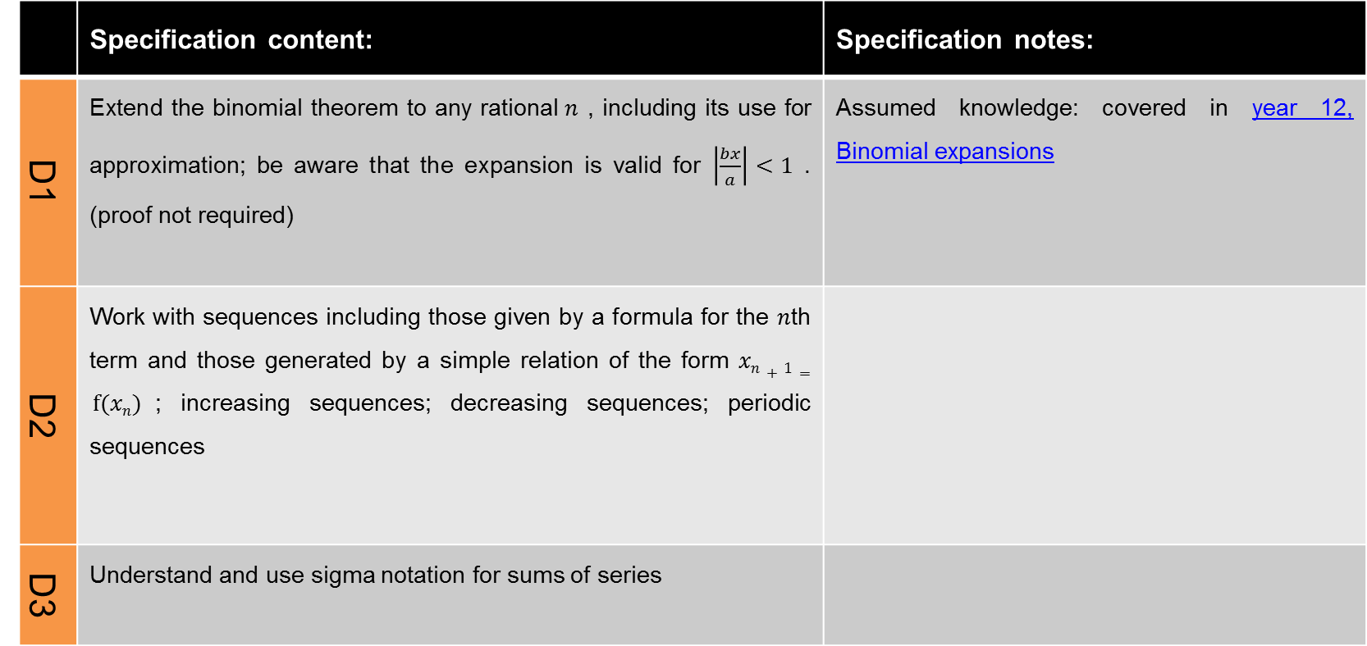
Binomial theorem, sequences and series (slide 1 of 2)
 | Specification content: | Specification notes:
D1 | Extend the binomial theorem to any rational$n$ , including its use for approximation; be aware that the expansion is valid for $\left|\frac{bx}{a}\right|<1$ . (proof not required) | Assumed knowledge: covered in year 12, Binomial expansions
D2 | Work with sequences including those given by a formula for the $n$th term and those generated by a simple relation of the form $xn+1= f(xn)$; increasing sequences; decreasing sequences; periodic sequences
D3 | Understand and use sigma notation for sums of series
Continued on next page

Slide 45
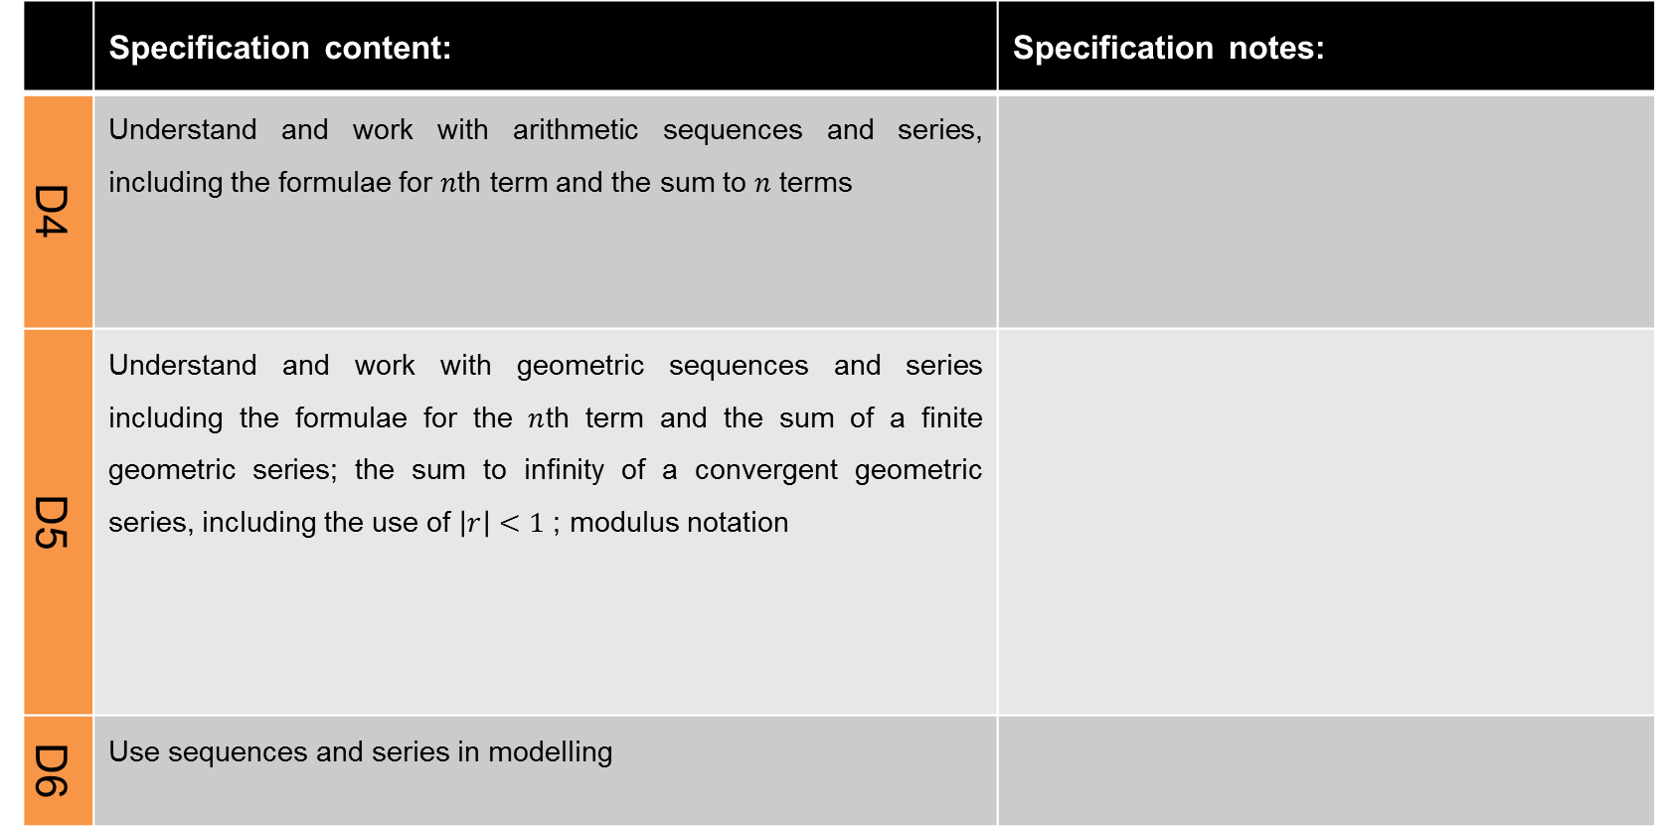
Binomial theorem, sequences and series (slide 2 of 2)
 | Specification content: | Specification notes:
D4 | Understand and work with arithmetic sequences and series, including the formulae for $n$th term and the sum to $n$ terms
D5 | Understand and work with geometric sequences and series including the formulae for the $n$th term and the sum of a finite geometric series; the sum to infinity of a convergent geometric series, including the use of $\left|r\right|<1$ ; modulus notation
D6 | Use sequences and series in modelling

Slide 46
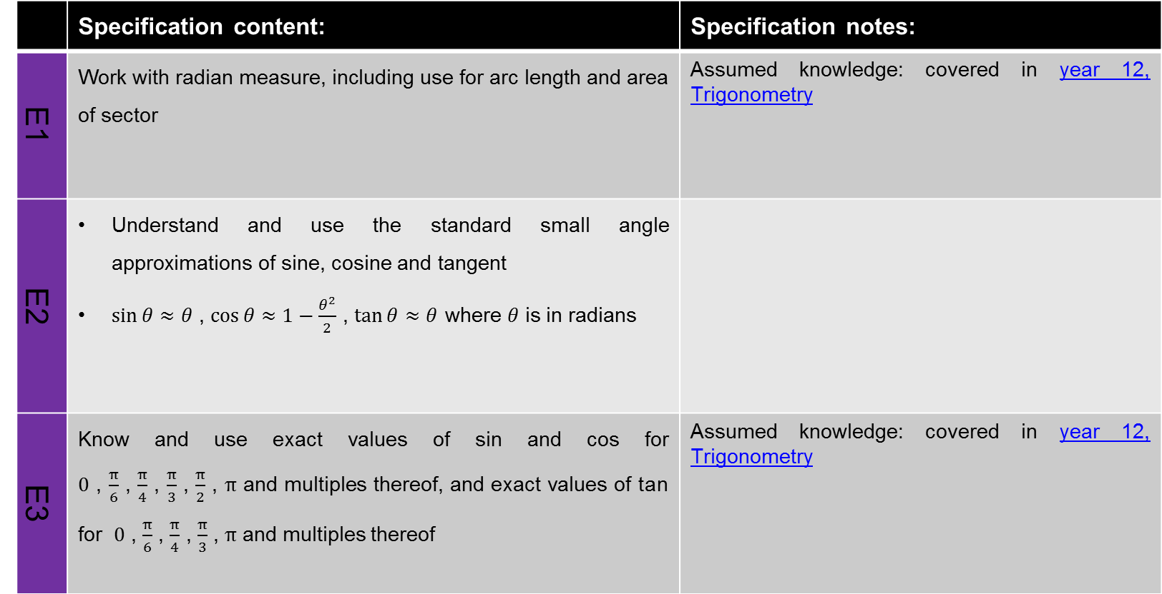
Trigonometry and circular measure (slide 1 of 2)
 | Specification content: | Specification notes:
E1 | Work with radian measure, including use for arc length and area of sector | Assumed knowledge: covered in year 12, Trigonometry
E2 | Understand and use the standard small angle approximations of sine, cosine and tangent $\sin{θ}≈θ$ , $\cos{θ≈1−\frac{θ^{2}}{2}}$ , $\tan{θ≈θ}$ where $θ$ is in radians
E3 | Know and use exact values of sin and cos for $0$ , $\frac{π}{6}$ , $\frac{π}{4}$ , $\frac{π}{3}$ , $\frac{π}{2}$ , $π$ and multiples thereof, and exact values of tan for $0$ , $\frac{π}{6}$ , $\frac{π}{4}$ , $\frac{π}{3}$ , $π$ and multiples thereof | Assumed knowledge: covered in year 12, Trigonometry
Continued on next page

Slide 47
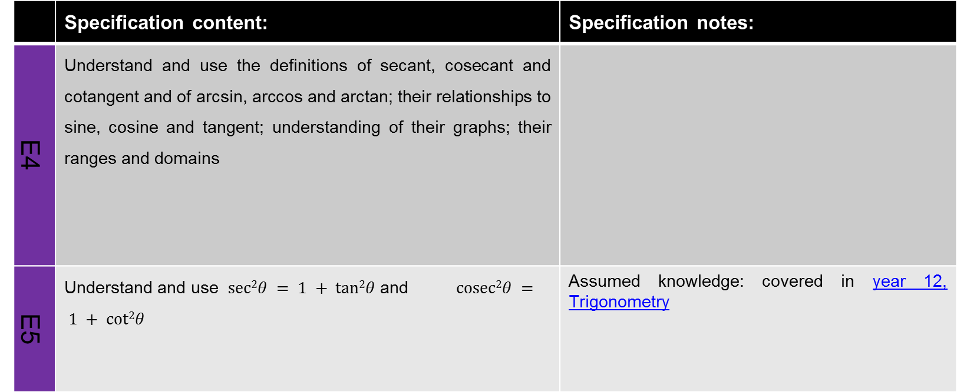
Trigonometry and circular measure (slide 2 of 2)
 | Specification content: | Specification notes:
E4 | Understand and use the definitions of secant, cosecant and cotangent and of arcsin, arccos and arctan; their relationships to sine, cosine and tangent; understanding of their graphs; their ranges and domains
E5 | Understand and use $sec2θ = 1 + tan2θ$and $cosec2θ = 1 + cot2θ$ | Assumed knowledge: covered in year 12, Trigonometry

Slide 48
Functions and transformations
 | Specification content: | Specification notes:
B6 | Simplify rational expressions including by factorising and cancelling, and algebraic division (by linear expressions only) | Assumed knowledge: covered in year 12, Algebraic manipulation, quadratic equations and simultaneous equations
B7 | The modulus of a linear function | Assumed knowledge: covered in year 12, Graphs, linear and quadratic inequalities
B8 | Understand and use composite functions; inverse functions and their graphs
B9 | Combinations of transformations (translations and stretches) | Assumed knowledge: covered in year 12, Graphs, linear and quadratic inequalities

Slide 49
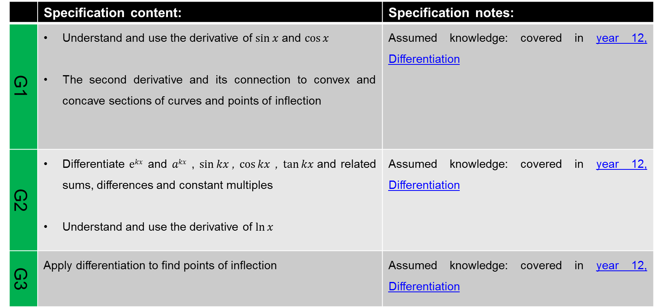
Further differentiation (slide 1 of 2)
 | Specification content: | Specification notes:
G1 | Understand and use the derivative of $sin⁡x$ and $cos⁡x$ The second derivative and its connection to convex and concave sections of curves and points of inflection | Assumed knowledge: covered in year 12, Differentiation
G2 | Differentiate $ekx$ and $akx$ , $sin⁡kx$, $cos⁡kx$ , $tan⁡kx$and related sums, differences and constant multiples Understand and use the derivative of $ln⁡x$ | Assumed knowledge: covered in year 12, Differentiation
G3 | Apply differentiation to find points of inflection | Assumed knowledge: covered in year 12, Differentiation
Continued on next page

Slide 50
Further differentiation (slide 2 of 2)
 | Specification content: | Specification notes:
G4 | Differentiate using the product rule, the quotient rule and the chain rule, including problems involving connected rates of change and inverse functions | Assumed knowledge: covered in year 12, Differentiation

Slide 51
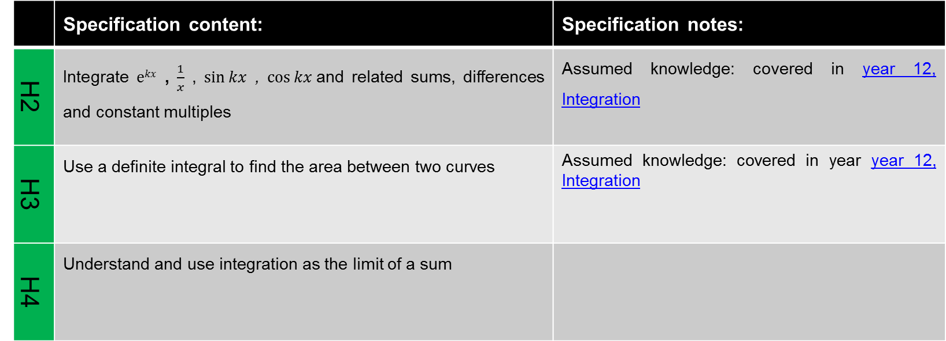
Further integration (slide 1 of 2)
 | Specification content: | Specification notes:
H2 | Integrate $ekx$ , $\frac{1}{x}$ , $sin⁡kx$ , $cos⁡kx$and related sums, differences and constant multiples | Assumed knowledge: covered in year 12, Integration
H3 | Use a definite integral to find the area between two curves | Assumed knowledge: covered in year year 12, Integration
H4 | Understand and use integration as the limit of a sum
Continued on next page

Slide 52
Further integration (slide 2 of 2)
 | Specification content: | Specification notes:
H5 | Carry out simple cases of integration by substitution and integration by parts; understand these methods as the inverse processes of the chain and product rules respectively (Integration by substitution includes finding a suitable substitution and is limited to cases where one substitution will lead to a function which can be integrated; integration by parts includes more than one application of the method but excludes reduction formulae)

Slide 53
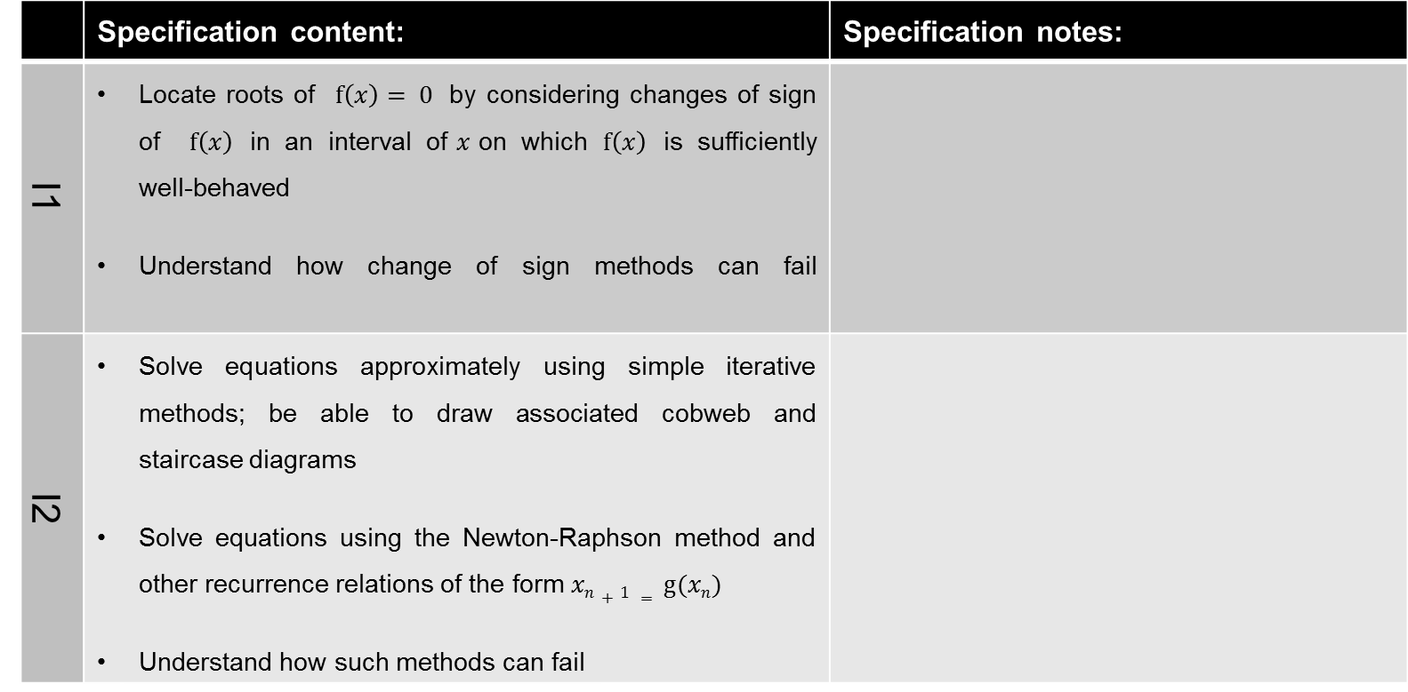
Numerical methods (slide 1 of 2)
 | Specification content: | Specification notes:
I1 | Locate roots of $f\left(x\right)= 0$ by considering changes of sign of $f\left(x\right)$ in an interval of$x$on which $f\left(x\right)$ is sufficiently well-behaved Understand how change of sign methods can fail
I2 | Solve equations approximately using simple iterative methods; be able to draw associated cobweb and staircase diagrams Solve equations using the Newton-Raphson method and other recurrence relations of the form $xn+1 = g(xn)$ Understand how such methods can fail
Continued on next page

Slide 54
Numerical methods (slide 2 of 2)
 | Specification content: | Specification notes:
I3 | Understand and use numerical integration of functions, including the use of the trapezium rule and estimating the approximate area under a curve and limits that it must lie between
I4 | Use numerical methods to solve problems in context

Slide 55
Parametric equations
 | Specification content: | Specification notes:
C3 | Understand and use the parametric equations of curves and conversion between Cartesian and parametric forms
C4 | Use parametric equations in modelling in a variety of contexts
G5 | Differentiate simple functions and relations defined implicitly or parametrically, for first derivative only

Slide 56
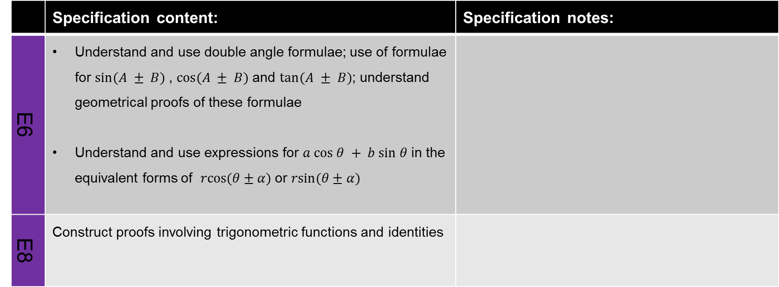
Trigonometry
 | Specification content: | Specification notes:
E6 | Understand and use double angle formulae; use of formulae for $sin⁡(A ± B)$, $cos⁡(A ± B)$and $tan⁡(A ± B)$; understand geometrical proofs of these formulae Understand and use expressions for $a cos θ + b sin θ$in the equivalent forms of $rcos(θ±α)$or $rsin(θ±α)$
E8 | Construct proofs involving trigonometric functions and identities

Slide 57
Partial fractions and integration
 | Specification content: | Specification notes:
B10 | Decompose rational functions into partial fractions (denominators not more complicated than squared linear terms and with no more than 3 terms, numerators constant or linear)
H6 | Integrate using partial fractions that are linear in the denominator

Slide 58
Differential equations (slide 1 of 2)
 | Specification content: | Specification notes:
B11 | Use of functions in modelling, including consideration of limitations and refinements of the models
G5 | Differentiate simple functions and relations defined implicitly, for first derivative only
G6 | Construct simple differential equations in pure mathematics and in context, (contexts may include kinematics, population growth and modelling the relationship between price and demand)
Continued on next page

Slide 59
Differential equations (slide 2 of 2)
 | Specification content: | Specification notes:
H7 | Evaluate the analytical solution of simple first order differential equations with separable variables, including finding particular solutions (Separation of variables may require factorisation involving a common factor)
H8 | Interpret the solution of a differential equation in the context of solving a problem, including identifying limitations of the solution; includes links to kinematics

Slide 60
Kinematics in two dimensions (slide 1 of 2)
 | Specification content: | Specification notes:
J1 | Use vectors in three dimensions | Assumed knowledge: covered in year 12, Vectors
J5 | Use vectors to solve problems in kinematics | Assumed knowledge: covered in year 12, Vectors
E9 | Use trigonometric functions to solve problems in context, including problems involving vectors, kinematics and forces
Q3 | Understand, use and derive the formulae for constant acceleration for motion in 2 dimensions using vectors | Assumed knowledge: covered in year 12, Kinematics in one dimension
Continued on next page

Slide 61
Kinematics in two dimensions (slide 2 of 2)
 | Specification content: | Specification notes:
Q4 | Use calculus in kinematics for motion in 2 dimensions using vectors | Assumed knowledge: covered in year 12, Kinematics in one dimension
Q5 | Model motion under gravity in a vertical plane using vectors; projectiles

Slide 62
Equilibrium and resolving
 | Specification content: | Specification notes:
R2 | Understand and use Newton’s second law for motion in situations where forces need to be resolved (restricted to 2 dimensions) | Assumed knowledge: covered in year 12, Forces and Newton’s laws
R4 | Resolving forces in 2 dimensions; equilibrium of a particle under coplanar forces | Assumed knowledge: covered in year 12, Forces and Newton’s laws

Slide 63
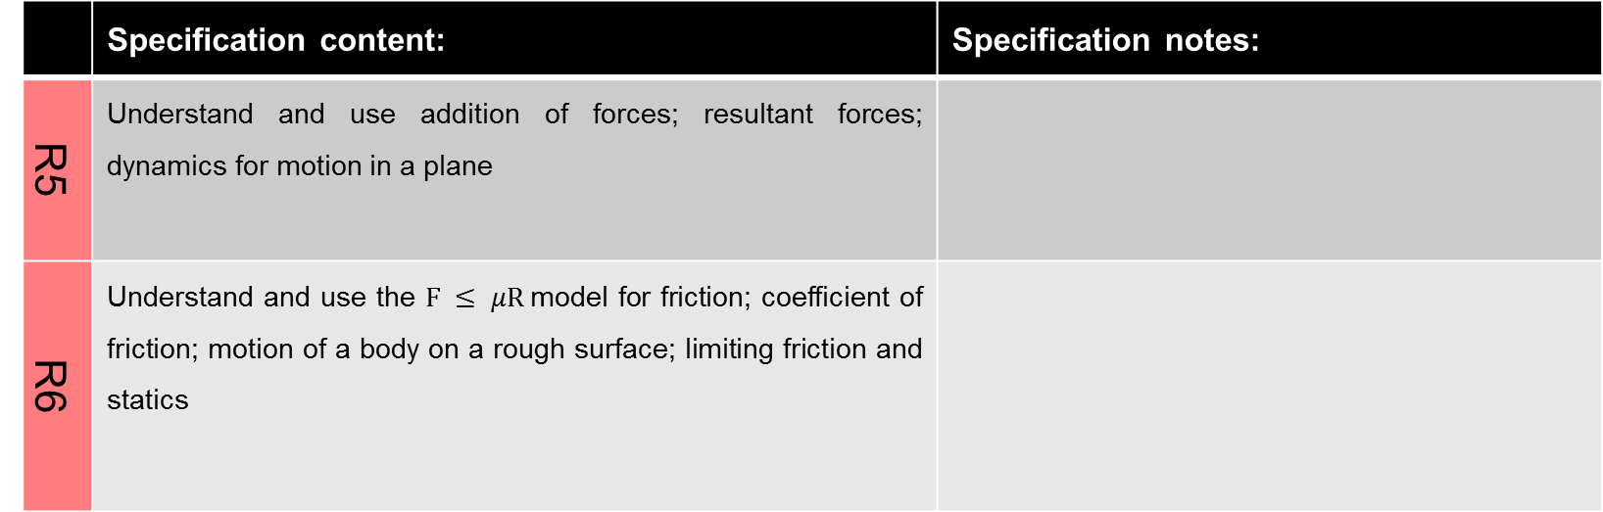
Statics and dynamics
 | Specification content: | Specification notes:
R5 | Understand and use addition of forces; resultant forces; dynamics for motion in a plane
R6 | Understand and use the $F ≤ μR$model for friction; coefficient of friction; motion of a body on a rough surface; limiting friction and statics

Slide 64
Moments
 | Specification content: | Specification notes:
P1 | Understand and use derived quantities and units: moment | Assumed knowledge: covered in year 12, Kinematics in one dimension
S1 | Understand and use moments in simple static contexts

Slide 65
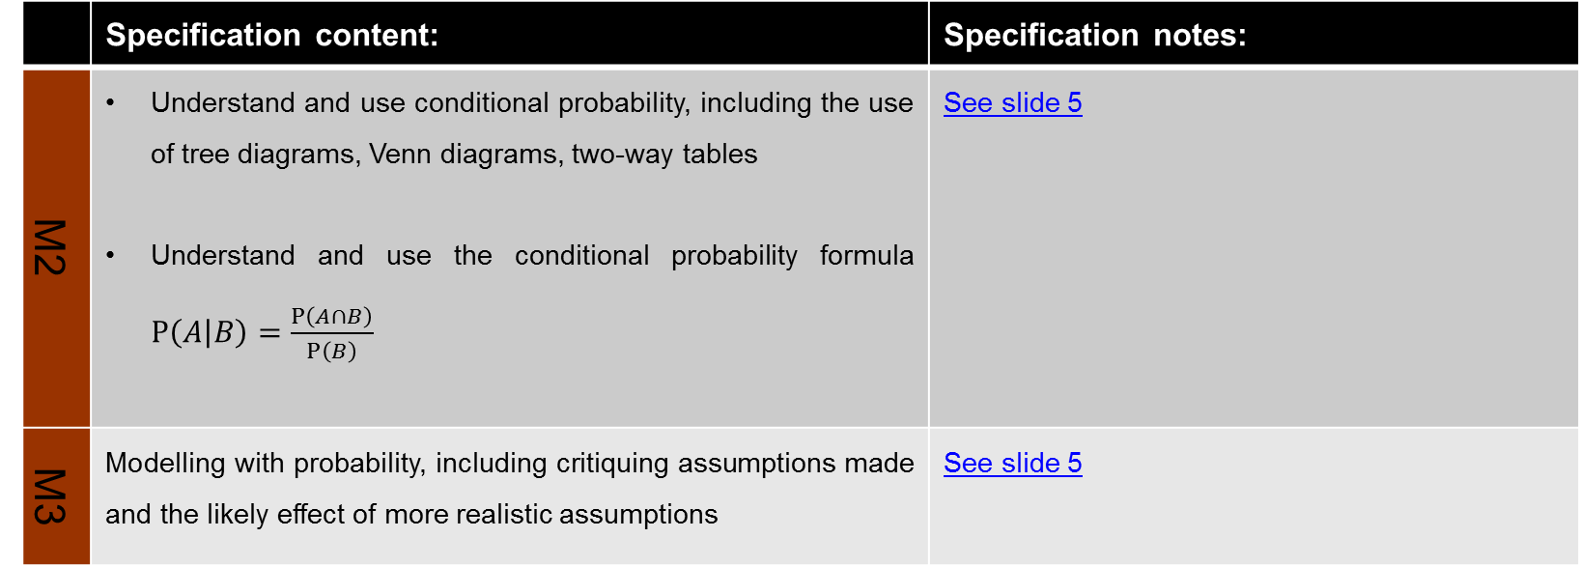
Continued on next page
Further probability
 | Specification content: | Specification notes:
M2 | Understand and use conditional probability, including the use of tree diagrams, Venn diagrams, two-way tables Understand and use the conditional probability formula $P\left(A | B\right)=\frac{P\left(A∩B\right)}{P\left(B\right)}$ | See slide 5
M3 | Modelling with probability, including critiquing assumptions made and the likely effect of more realistic assumptions | See slide 5

Slide 66
Continued on next page
Statistical distributions
 | Specification content: | Specification notes
N2 | Understand and use the Normal distribution as a model; find probabilities using the Normal distribution Link to histograms, mean, standard deviation, points of inflection and the binomial distribution | See slide 5
N3 | Select an appropriate probability distribution for a context, with appropriate reasoning, including recognising when the binomial or Normal model may not be appropriate

Slide 67
Continued on next page
Statistical hypothesis testing
 | Specification content: | Specification notes
O1 | Understand and apply correlation coefficients as measures of how close data points lie to a straight line and be able to interpret a given correlation coefficient using a given p-value or critical value (calculation of correlation coefficients is excluded) | See slide 5 Assumed knowledge: covered in year 12, Statistical hypothesis testing
O3 | Conduct a statistical hypothesis test for the mean of a Normal distribution with known, given or assumed variance and interpret the results in context | See slide 5

